Slide 1
Data Analytics – Lesson 7 Introduction to Python
Jeffrey Strickland, Ph.D.

Slide 2

What is Required by Data Analytics?
Integrate
Analyze
Visualize
V1 | V2 | V3 | V4
1 | 14.23 | 1.71 | 2.43
1 | 13.20 | 1.78 | 2.14
1 | 13.16 | 2.36 | 2.67
1 | 14.37 | 1.95 | 2.50
1 | 13.24 | 2.59 | 2.87
https://portal.azure.com/#dashboard/private/6245138c-3a35-4e4f-8cf6-d8fe27b9b026

Slide 3
Class Content
Overview
Python Building Blocks
Best Practices
Data Structures
Lambdas & Sequence Functions
Files
Modules
Notes:
Suggestions for overall scenarios:
tracking website clicks project

Slide 4
Overview

Slide 5
Overview
Introduction
Python Use Cases
Compilation & Execution

Slide 6
Why Python?
Open Source
Interpreted (byte-code compiled)
Converted to machine code on each execution
Pre-built libraries & Active Community
Python downloads with a large amount of pre-built libraries, such as random and re. It also supports third party modules, such as Pandas.
Enforces Coding Standards
PEP8 Style Guide recommended for readability
Notes:
Interpreted - Source code is converted to machine code then executed each time the program runs
Compiled - Source code is converted to machine code only once, then the resulting compilation is executed each time a program runs.

Slide 7
Why Python?
Dynamic/Developer Productivity
Memory allocation and variable type declaration are abstracted
Platform Agnostic
Results are independent of OS
Object Oriented
Programs are built around objects
Notes:
Interpreted - Source code is converted to machine code then executed each time the program runs
Compiled - Source code is converted to machine code only once, then the resulting compilation is executed each time a program runs.

Slide 8
Python History
Version 2.x | Version 3.x
“Legacy” - Last major release in 2010. | Ongoing development - Major releases each year since 2012
 | Less extensive library support
 | Slight Syntactical Difference
 | Comparable Performance

Slide 9
Python Usage Examples
Data Analysis
Modules such as: numpy, scipy, pandas, matplotlib
Task Automation
Web Development/ Web Scraping
Frameworks such as Django and Flask
Rapid Prototyping
IPython
Internet of Things
Raspberry Pi

Slide 10
Writing Python - IDE/Notepad
An Integrated Development Environment (IDE) is a place to write and execute code. IDEs often include tools for debugging and code management. Examples include:
IDLE (comes with Python)
Pycharm
A notepad application can also be used to write code, but the code will execute elsewhere. Examples include:
Notepad++
Sublime Text

Slide 11
Writing Python - Interactive Shell
The python shell provides an area in which code can be rapidly tested for functionality, as results are immediately returned.
[ec2-user@ip-172-31-43-49 ~]$ python
Python 2.7.12 (default, Sep 1 2016, 22:14:00)
[GCC 4.8.3 20140911 (Red Hat 4.8.3-9)] on linux2
Type "help", "copyright", "credits" or "license" for more information.
>>> print ("Hello")
Hello

Slide 12
Writing Python - Interactive Shell
The shell works equivalently to standard script execution.
>>> print (Hello)
Traceback (most recent call last):
File "<stdin>", line 1, in <module>
NameError: name 'Hello' is not defined
>>> def printHello():
... print("Hello")
...
>>> printHello()
Hello

Slide 13
Writing Python - CLI
CLI = Command Line Interface
Execute the following in a shell, requires python path to be set:
Check Python installation: python -- version
Launch interactive shell by using python
>>> denotes the interactive shell
Command are interpreted
Exit interactive shell through exit()
Notes:
The path provides a shortcut to the installation folder of python. Current downloads allow this to be set through a checkbox during installations.
Windows:
Advanced System Settings -> Environment Variables -> PATH -> Add ;<path_to_python/bin>
Unix:
export PATH=PATH:<path_to_python/bin>

Slide 14
Writing Python - CLI
Execute python programs by specifying file name to launch:
python <filename>.py or
./<filename>.py (first chmod +x <filename>.py)
where <filename>.py contains #! /usr/bin/python2.7
Example:
[ec2-user@ip-172-31-43-49 ~]$ cat hello.py
#! python2.7
print("Hello")
[ec2-user@ip-172-31-43-49 ~]$ python hello.py
Hello

Slide 15
Core Concepts

Slide 16
Common Data Types
int
2
5
float
2.0
5.1
string
"abc"
'abc'
'''abc'''
"""abc"""
list - []
[2,5.0,"abc"]
dictionary - {}
{key:value}
set - set()
set([2,5.0,"abc"])
tuple - ()
(2,5,"abc")

Slide 17
Variable Assignment
Variables hold an object's value in memory. Python does not require the variable type to be explicitly defined, but does require an initial value to be provided.
Example:
>>> companyName = "Clarity Insights"
>>> print(companyName)
Clarity Insights
>>> print(id(companyName)) # some memory address
71051568

Slide 18
Variable Assignment
Variables can be reassigned as a script runs.
Example:
>>> import time
>>> now = time.strftime("%c") # Local date and time representation.
>>> print(now)
05/04/17 20:18:42
>>> now = time.strftime("%c")
>>> print(now)
05/05/17 21:24:37

Slide 19
Function Overview
Functions are callable blocks of code which are intended to solve particular tasks. Functions reduce code duplication, support troubleshooting, and enhance code readability.
print() and id() are functions we have seen already.
Calling functions follow the pattern below:
<function_name> ( <parameters> )

Slide 20
Function Overview
Python installs with many built-in functions and libraries. To explore the various methods and usage of these functions, use the help() or dir() functions.
>>> import re # regular expression library
>>> dir(re) # lists all available functions a class offers
['A', 'ASCII', …… 'sys', 'template']
>>> help(re.findall) # details a particular methods usage
Help on function findall in module re:
findall(pattern, string, flags=0) ……
Notes:
https://docs.python.org/2/library/functions.html
dir() lists all the methods of a module class
help() provides manual-style documentation on a particular function or class

Slide 21
Function Overview
Functions can call other functions (or call themselves)
>>> print(type(123))
<class 'int'>
Function results can be stored into variables
>>> x = print(type(123))
<class 'int'>

Slide 22
Function Overview
A return value is an object that becomes accessible outside of the scope of the function. Functions do not require return values. A function without a return statement returns a None type. Code in a function after a return statement does not execute.
>>> x = print(type(123)) #storing a print result is None type
<class 'int'>
>>> x
>>> print(x)
None

Slide 23
Function Terminology
>>> def multiplyByEight(number=100):
return number*8
>>> multiplyByEight(10)
80
Name
Parameter
Default Value
Function Call
Argument

Slide 24
User Defined Functions
Custom functions can be created using the following format (italics are optional):
def <function_name>( <parameters> =<default_value> ):
# tab indentation
# code here
# things happen
return <result>

Slide 25
User Defined Functions
Function names should be descriptive of the function purpose.
Default values are overridden by arguments passed by the function call.
>>> def curveGrade(score=0):
return score*(4/5)+20
>>> curveGrade(80)
84.0
>>> curveGrade() # uses default value for the parameter
20.0

Slide 26
Using Modules
Python modules are collections of functions which accomplish a wide variety of tasks, such as:
Creating data structures for data analysis (pandas)
Tools for working with XML files (etree)
Tools for parsing HTML files (beautifulsoup)
Pattern matching strings (re)
Using advanced math operations (math)
Some of these modules download with Python. Explore the */Lib/ directory of your python install to view list and examine the source code.
Notes:
https://anaconda.org/ offers numerous packages to install easily in an all-in-one package, such as numpy and pandas.
https://docs.python.org/2/library/functions.html for a list of functions built into python (usable without import)
https://docs.python.org/2/library/index.html for a list of libraries included with python (usable with import)

Slide 27
Using Modules
To use a module in your Python code, it must first be brought into the program through an import statement.
>>> import math # imports all the math module functions
>>> factorial(5)
Traceback … … NameError: name 'factorial' is not defined
>>> math.factorial(5) # module functions need to be identified
120
>>> from math import factorial # import factorial function directly
>>> factorial(5) # math.* prefix not required in this approach
120
Notes:
Importing all modules vs importing only required module dicussion: http://stackoverflow.com/questions/710551/import-module-or-from-module-import

Slide 28
Python Namespace
Namespace in python is the collection of all objects given names in your programs scope. These can be modules such as math, or variables such as x, y, etc. You can view the namespace of your function through the dir() function.
>>> dir()
['__builtins__', '__doc__', '__loader__', '__name__', '__package__', '__spec__', ...<custom variables or imports>]
This concept has greater importance when an importing module has the same variable names used in the importing script.
Notes:
Importing all modules vs importing only required module dicussion: http://stackoverflow.com/questions/710551/import-module-or-from-module-import

Slide 29
Module Import differences
import <module> brings the specified module into the python namespace. Accessing its contents requires a call to the object.
>>> import math # imports all the math module functions
>>> dir()
['__builtins__', '__doc__', '__loader__', '__name__', '__package__', '__spec__', math]
>>> math.factorial(5) # module functions need to be identified
>>> dir(math) #viewing contents of the math module namespace
['__doc__', '__loader__', '__name__', '__package__', '__spec__', 'acos', 'acosh', 'asin', 'asinh', 'atan', 'atan2', 'atanh', 'ceil', 'copysign', … , 'tan', 'tanh', 'trunc']
Notes:
Importing all modules vs importing only required module dicussion: http://stackoverflow.com/questions/710551/import-module-or-from-module-import

Slide 30
Module Import differences
from <module> import <function> brings the specified function into the python namespace directly. This will overwrite any names you may already have defined.
>>> from math import factorial # imports only factorial
>>> dir()
['__builtins__', … '__spec__', factorial]
>>> factorial(5) # function is in top level namespace
120
>>> factorial = 1 # Changing value in top level namespace
>>> factorial(5) # error: factorial not callable
Notes:
Importing all modules vs importing only required module dicussion: http://stackoverflow.com/questions/710551/import-module-or-from-module-import

Slide 31
Using External Modules
Python’s pip utility can be used to easily install third party modules. Modules can be installed and updated from the command line using pip.
[ec2-user@ip-172-31-26-178 ~]$ sudo pip install SQLAlchemy
Collecting SQLAlchemy
Downloading SQLAlchemy-1.1.9.tar.gz (5.2MB)
100% |████████████████████████████████| 5.2MB 91kB/s
Installing collected packages: SQLAlchemy
Running setup.py install for SQLAlchemy
Successfully installed SQLAlchemy-1.1.9
Notes:
On client sites, the pip utility might not be used for certain environments relying on other methods of making modules available.

Slide 32
Using External Modules
A successful install will result in a function’s import statement returning without error.
[ec2-user@ip-172-31-26-178 ~]$ python
Python 2.7.12 (default, Sep 1 2016, 22:14:00)
[GCC 4.8.3 20140911 (Red Hat 4.8.3-9)] on linux2
Type "help", "copyright", "credits" or "license" for more information.
>>> import sqlalchemy
>>>

Slide 33
Mathematical Operators
+ | Addition
- | Subtraction
* | Multiplication
/ | Division
// | Floor Division
% | Remainder
** | Exponent
Notes:
https://www.tutorialspoint.com/python/python_basic_operators.htm

Slide 34
Lab: Basic Functions
Function Creation Lab
Notes:
~5-10 minutes estimated completion time for lab.
Questions
https://drive.google.com/open?id=0B90M9zcytaovOFlwRUZiQ3FrNGc
Answers
https://drive.google.com/open?id=0B90M9zcytaovWVk1MmkzTzBEQ0E

Slide 35
Control Structures
Control Structures allow for controlled code execution based on specified conditions through the usage of conditional operators.
if ( <some_condition> ):
# tab indentation
# something happens
elif ( <some_other_condition> ):
# something different happens
# this block is optional
else:
# a default condition happens
# this block is optional

Slide 36
Conditional Operators
> | TRUE if the left value is greater than the right.
< | TRUE if the left value is less than the right.
>= | TRUE if the left value if greater than or equal to the right
<= | TRUE if the left value if less than or equal to the right
== | TRUE if the left value if is equal to the right
!= | TRUE if the left value if is not equal to the right
Notes:
https://www.tutorialspoint.com/python/python_basic_operators.htm

Slide 37
Control Structures Example
>>> def factorial(n):
if ( n==0 ):
return 1
else:
return n * factorial(n-1)
>>> factorial(5)
120
>>> factorial(15)
1307674368000

Slide 38
Lab: Control Structures
Control Structures Lab
Notes:
Questions
https://drive.google.com/open?id=0B90M9zcytaovXzJFNHJiYVluMVE
Answers
https://drive.google.com/open?id=0B90M9zcytaovXzJhNnI4cTJCeXc

Slide 39
Error Handling
Python errors are called exceptions. There are many built in exceptions. They can also be user defined.
Common exception errors:
SyntaxError: unexpected indent
NameError: name '<variable>' is not defined
A variable was called, but never initialized
ZeroDivisionError: division by zero
ModuleNotFoundError: No module named '<module>'
Module not installed correctly, or invoked incorrectly
Notes:
https://docs.python.org/2/library/exceptions.html

Slide 40
Error Handling
A program which encounters an exception error without properly handling it will terminate, and throw the terminating exception to the console.
def divideTwoNumbers(num,denom):
return num/denom
print(divideTwoNumbers(1,2))
print(divideTwoNumbers(5,5))
print(divideTwoNumbers(4,0))
0.5
1.0
Traceback … ZeroDivisionError: division by zero
Notes:
https://docs.python.org/2/library/exceptions.html

Slide 41
Error Handling
Use a try / except block to handle errors without terminating.
try:
# some code to attempt
except <Errors to Handle>:
# code to execute if try block experienced error listed
# optional section.
# specifying no errors will catch all known exceptions
finally:
# code which always executes
# optional section
Notes:
https://docs.python.org/2/library/exceptions.html

Slide 42
Error Handling
def divideTwoNumbers(num,denom):
try:
return num/denom
except ZeroDivisionError:
return "Cannot Divide By Zero"
print(divideTwoNumbers(1,2))
print(divideTwoNumbers(5,5))
print(divideTwoNumbers(4,0))
0.5
1.0
Cannot Divide By Zero

Slide 43
Lab: Error Handling
Error Handling Lab
Notes:
Estimated to take ~10-15m
Questions
https://drive.google.com/open?id=0B90M9zcytaovRThnVE1XcnBvTzA
Answers
https://drive.google.com/open?id=0B90M9zcytaovQk5iemx4U0hLcWM

Slide 44
Debugging
The term “bug” allegedly originated from actual bugs, such as moths, causing undesired behavior in large, early computers, by getting in the way of correct operation.
Debugging is a method of analyzing and resolving issues in problem code.
In the next lab, try to debug the issue in the problem code.

Slide 45
Lab: Debugging
Debugging Lab
Notes:
Estimated to take ~5-10m. Will require a brief overview of lists.
Questions
https://drive.google.com/open?id=0B90M9zcytaovemNydm1FZDN1SGs
Answers
https://drive.google.com/open?id=0B90M9zcytaovc0R1dE9zNEhRblU

Slide 46
Pythonic Thinking
Programming Paradigms
Main() Function
Problem Solving

Slide 47
Procedural Programming
Using statements and functions to control program flow
>>> studentName = "John" # a statement
>>> print(studentName) # a function call
Notes:
From Stack Overflow (https://stackoverflow.com/questions/552336/oop-vs-functional-programming-vs-procedural ):
... paradigms don't have to be mutually exclusive. If you look at python, it supports functions and classes, but at the same time, everything is an object, including functions. You can mix and match functional/oop/procedural style all in one piece of code.
In python, a function is a first-class citizen, but it can contain arbitrary number of statements. So you can have a function that contains procedural code, but you can pass it around just like functional languages.
Same goes for OOP. A language like Java doesn't allow you to write procedures/functions outside of a class. The only way to pass a function around is to wrap it in an object that implements that function, and then pass that object around.
In Python, you don't have this restriction
From other places on the web (http://www.ctp.bilkent.edu.tr/~russell/java/LectureNotes/1_OOConcepts.html ) :
The design method used in procedural programming is called Top Down Design. This is where you start with a problem (procedure) and then systematically break the problem down into sub problems (sub procedures). This is called functional decomposition, which continues until a sub problem is straightforward enough to be solved by the corresponding sub procedure. The difficulties with this type of programming, is that software maintenance can be difficult and time consuming. When changes are made to the main procedure (top), those changes can cascade to the sub procedures of main, and the sub-sub procedures and so on, where the change may impact all procedures in the pyramid.

Slide 48
Object Oriented Programming
OOP is procedural programming but with objects
What is the purpose of OOP?
To hide implementation details that we do not care about
For instance, which one do you prefer?
wake up, brush your teeth, change clothes, eat breakfast, grab your bag, get into car, turn on car, drive ten minutes to school, park car, get out of car, walk ten minutes to class, enter class, and sit down. or …
get to class on time
In OOP programming, the above can be illustrated like so:
>>> student = Student("Nancy")
>>> student.getToClassOnTime()

Slide 49
OOP Terminology
Class: A blueprint for an object. The class defines the properties and methods that an object of that class will have.
Object: an object created from a specific class
Constructor/Initializer: the thing that creates an object from a class (in Python, it is the function __init__)

Slide 50
OOP Terminology
Self: variable in a class that refers to the created object
Properties: the attributes of the object
Methods: the things that an object can do

Slide 51
OOP Concepts: Defining a Class
To define a class, use the class keyword followed by the class name. Inside that code block, define an __init__(self) function that initializes the properties of an object. Under that, define the methods of that class.
class <className>():
def __init__(self, <param>): # defining the initializer
self.<variable> = <param>
def <additionalMethods>(self): # defining methods
self.<variable> = <value>

Slide 52
OOP Concepts: Defining a Class
Example:
class Student():
def __init__(self, aName): # defining the initializer
self.name = aName # name initialized to aName
self.motivated = False # motivated initialized to False
def study(self): # defining the study method
self.motivated = True
self.read()
def read(self): # defining the read method
print("I’m reading.")

Slide 53
OOP: Quick Side Note
Question: Why do I see so many self in the class?
Answer: Python was not originally designed to be object oriented. In order to incorporate OOP concepts into Python, the language needed changes. When you see the self keyword in the method declarations, just accept that it needs to be there. When you call an object’s method, you can pretend that the variable self is not part of the required list of arguments that you need to supply to that method.

Slide 54
OOP Concepts: Creating an Object
To create an object, write the class name followed by (<arguments>).
The number of arguments that you specify in the () is determined by how many arguments are defined in the __init__ method.
For the Student class, specify one argument, since __init__ requires one argument called aName.
>>> student = Student("Josh")

Slide 55
OOP Concepts: Working with Properties
To access or change an object’s properties, use the syntax:
<object name>.<object property>
>>> student.name
‘Josh’
>>> student.name = "Joshua"
>>> student.name
‘Joshua’

Slide 56
OOP Concepts: Working with Methods
To call an object’s method, use the syntax:
<object name> . <object method>(<parameters>)
>>> student.study() # study in this example has no parameters
I’m reading
Notes:
Further reading: https://jeffknupp.com/blog/2014/06/18/improve-your-python-python-classes-and-object-oriented-programming/

Slide 57
Lab: Creating Your Own Class
Custom Class Creation Lab
Notes:
Questions
https://drive.google.com/open?id=0B90M9zcytaovckU4aUNuWmNLbmM
Answers
https://drive.google.com/open?id=0B90M9zcytaovbHVhOW95QjRrU1U

Slide 58
Inheritance
Inheritance is the idea that new classes, called the child class, can be derived from existing classes, called the parent class.
Through inheritance, child classes inherit all of the properties and methods from their parent class.
Child classes can also have their own properties and methods in addition to the ones that were inherited.

Slide 59
Inheritance Example
class Person():
def __init__(self, name):
self.name = name
def greet(self):
print(“Hi, my name is “ + self.name)
class Student(Person):
def __init__(self, name, school):
Person.__init__(self, name)
self.school = school
def study(self):
print(“I am studying”)
>>> s = Student(“Julie”, “University of Notre Dame”)
>>> s.study()
I am studying
>>> s.greet()
Hi, my name is Julie

Slide 60
Inheritance: Method Resolution
In the previous example, the parent class is the Person class and the child class is the Student class. greet is a method that Student inherited from Person and study is a new method that was defined.
The previous example also illustrates the concept of method resolution. Method resolution works like this. When a method is called, Python will execute the method in the lowest class that defines it. In this case, Python checks if greet was defined in Student. Since it was not, Python then looks for greet in the Person class. Python finds it and executes it.

Slide 61
Inheritance: Method Override
What if we wanted the greet method to behave differently for Student objects?
We can make use of a concept called method override. Method override allows child classes to redefine the behavior of inherited methods. In this case, if we redefine greet in the Student class, we will override the greet method defined in the Person class.
And according to method resolution, the new greet method in the Student class will be executed, not the greet in Person.

Slide 62
Inheritance: Method Override Example
class Person():
def __init__(self, name):
self.name = name
def greet(self):
print(“Hi, my name is “ + self.name)
class Student(Person):
def __init__(self, name, school):
Person.__init__(self, name)
self.school = school
def study(self):
print(“I am studying”)
def greet(self):
print(“Hi, I’m “ + self.name + “ and I go to “ + self.school)
>>> s = Student(“Julie”, “University of Notre Dame”)
>>> s.study()
I am studying
>>> s.greet()
Hi, I’m Julie and I go to University of Notre Dame

Slide 63
Inheritance: Method Override Example
Parent class values are accessible even when redefined at lower class levels. See that the parent values are still stored in their memory addresses and still available, by reviewing the objects from the Person and Student class example:
>>> p=Person("Jack")
>>> p.greet()
Hi, my name is Jack
>>> s.greet()
Hi, I’m Julie and I go to University of Notre Dame

Slide 64
Functional Programming
Functional Programming is a programming paradigm that requires that all functions have no side effects. A function does exactly what it says, nothing more, and nothing less.
Functional:
>>> def getClassGrade():
… return ‘A’
…
>>> getClassGrade()
‘A’
Non Functional:
>>> def getClassGrade():
… print("I’m a side effect")
… return ‘A’
…
>>> getClassGrade()
I’m a side effect
‘A’

Slide 65
Literate Programming
Literate Programming is a style of programming that makes your code read like a book/story.
The key to this style of programming is to use descriptive names for your variables, functions/methods, and classes.

Slide 66
Literate Programming Example
englishClass = Class("English")
teacher = Teacher("Mrs. Anderson")
student = Student("Laura Wells")
englishClass.setAsTeacher(teacher)
englishClass.setAsStudent(student)
class.start()

Slide 67
Lab: Literate Programming
Literate Programming Lab
Notes:
Questions
https://drive.google.com/open?id=0B90M9zcytaovRk1xSzlmTVRVcVk
Answers
https://drive.google.com/open?id=0B90M9zcytaovZ3h1STUzajVCNk0

Slide 68
Resources for Literate Prog.
PEP8
https://www.python.org/dev/peps/pep-0008/
Clean Code: A Handbook of Agile Software Craftsmanship by Robert Cecil Martin

Slide 69
Main Function
The main function is the entry point for programs written in traditional programming languages such as C, C++, and Java.
In Python, we mimic this behavior by defining a main function and calling it in a special if statement.

Slide 70
Main Function
def main():
print("Start of program")
print("Hello, World")
print("End of program")
if __name__ == "__main__":
main()
Think of the special statement if __name__ == "__main__": as saying “if this program is called from the command line, then execute the following code.”

Slide 71
Problem Solving Approach
In the following sections, you will be given programming exercises to solve. When solving these exercises, it is helpful to follow the approach described on the next slide.

Slide 72
Problem Solving Approach
Approach:
After hearing the problem, ask clarifying questions
Determine the input
Determine the output
Determine assumptions
Brainstorm different approaches/solutions
Select best approach, write the steps in English, and then in actual code
Test the code with test cases.

Slide 73
Lab: Problem Solving Approach
Problem Solving Approach Lab
Notes:
Questions
https://drive.google.com/open?id=0B90M9zcytaovQmVTeE9kVkVlX0k
Answers
https://drive.google.com/open?id=0B90M9zcytaovck91SG80bGpXUUk

Slide 74
Data Structures

Slide 75
Data Structures
Overview
List
Dictionary
Set
Tuple
Notes:
Suggestions for overall scenarios:
tracking website clicks project

Slide 76
What is a data structure?
A data structure is something that holds data. There are many different kinds of data structures, but we will be discussing four in this class:
list
dictionary
set
tuple

Slide 77
List
A Python list holds data in sequential order, like a list in real life, However, items in a Python list are numbered starting from zero.
You can picture a Python list as shown below. An item’s index is its position in the list.
Index: 0 1 2
List:
“book” | “class” | “school”

Slide 78
List
>>> l = []
>>> l.append(‘english’)
>>> l
[‘english’]
>>> l[0]
‘english’
>>> l.append(‘class’)
>>> l
[‘english’, ‘class’]
>>> l[1]
‘class’

Slide 79
List Operations
Operation | Description
[] | Create an empty list
[arg1, arg2, …, argn] | Create a list containing items
list[index] | Get the item in the list at the specified index. A negative index will return the item starting from the end of the list.
list[start:end] | Get the items of the list starting from index start all the way to 1 less than index end. This is also called list slicing
list[start:] | Get the items of the list starting from index start to the end
list[:end] | Get the items of the list starting from the beginning to 1 less than index end.
list[start:end:step] | Same as list[start:end], except only items at every step between start and end are included

Slide 80
List Operations
Operation | Description
len(list) | Get the number of items in the list
list.append(item) | Append an item to the end of the list
list.insert(index, item) or list[index] = item | Insert the item at the specified index in list
list.remove(item) | Removes the first occurrence of item from the list
del list[index] | Delete the item in the list at the specified index
list.sort() | Sorts the list
delim.join(list) | Takes the items of the list separated by delim and converts it into a string

Slide 81
List Iteration
To iterate through the items of a list from beginning to end, use this for statement:
for item in nameOfList:
# do stuff with item

Slide 82
List Comprehension
Alternatively, one can use list comprehension, which generally follows the following syntax:
new_list = [item for item in list optional_predicate]
What happens here is for every item in list, if the item makes the optional_predicate true, then include the item in new_list.
>>> evens = [num for num in range(0, 9) if num % 2 == 0]
[0,2,4,6,8]
In the process, you can also perform operations on item to change it.
>>> uppercase = [word.upper() for word in [“hello”, “world”]]
[‘HELLO’, ‘WORLD’]

Slide 83
Lab: Working with Lists 1
Working with Lists 1 Lab
Notes:
Questions
https://drive.google.com/open?id=0B90M9zcytaovUUtFSXBJeWJhWFE
Answers
https://drive.google.com/open?id=0B90M9zcytaovOUhuUnA0Y1J0NEk

Slide 84
Lab: Working with Lists 2
Working with Lists 2 Lab
Notes:
Questions
https://drive.google.com/open?id=0B90M9zcytaovbVJ4MC1Sc0o5YUU
Answers
https://drive.google.com/open?id=0B90M9zcytaovMmxaQ3cwY2hILTA

Slide 85
Dictionary
Python dictionaries map keys to values. What does that mean?
As a real world example, let’s discuss normal everyday dictionaries. Everyday dictionaries contain words and definitions. These dictionaries map a word (the key) to its definition (the value).
Python dictionaries work the same way. They map a key, which can be of any data type, to a value, which can also be of any data type.

Slide 86
Dictionary
>>> d = {}
>>> d[‘key’] = ‘value’
>>> d
{‘key’: ‘value’}
>>> d[3.14] = ‘pi’
>>> d
{‘key’: ‘value’, 3.14: ‘pi’}
>>> d[2] = 20
>>> d
{‘key’: ‘value’, 3.14: ‘pi’, 2: 20}

Slide 87
Dictionary Operations
Operations that one can perform on a dictionary are described below. Note, the phrase key value pair refers to the pairing of a key and its associated value.
Operation | Description
{} | Create an empty dictionary
{key1: value1, key2: value2} | Create a dictionary containing initial key value pairs
dictionary[key] | Get the value for the specified key
dictionary[key] = value | Create a new key value pair, or replace an existing key’s value with a new value
del dictionary[key] | Delete a key value pair

Slide 88
Dictionary Operations
Operation | Description
dictionary.keys() | Get a list of the keys of the dictionary
dictionary.values() | Get a list of the values of the dictionary
dictionary.items() | Get a list of the key value pairs of the dictionary

Slide 89
Dictionary
To iterate through the key value pairs of a dictionary use the following for statements, depending on your version of Python:
for key, value in dictionaryName.iteritems(): # Python 2
# do stuff with key and value
for key, value in dictionaryName.items(): # Python 3
# do stuff with key and value

Slide 90
Lab: Working with Dictionary
Working with Dictionary Lab
Notes:
Questions
https://drive.google.com/open?id=0B90M9zcytaovTmJZU3hpQm9SREE
Answers
https://drive.google.com/open?id=0B90M9zcytaovUTg5d1BWTkV0bm8

Slide 91
Set
A set is a mutable collection type which is made of objects that are
unique
immutable
To create a set, use the set() function as in the following example:
s1 = set(['architect', 'designer'])
The set itself is mutable, since it can be mutated (changed). To add an item to the set with an add() operation, try the following:
s1.add((2001, 2017))

Slide 92
Set
You can iterate over the objects in the set, as in the following:
>>> for item in s1:
print(item)
designer
architect
(2001, 2017)

Slide 93
Set
Python sets are like sets in math:
Operation | Description
intersection(x) | Return a new set with elements common to the set and x
difference(x) | Return a new set with elements in the set that are not in x
union(x) | Return a new set with elements from the set and x
Notes:
https://docs.python.org/3/library/stdtypes.html#set

Slide 94
Set
Additional operations appear below:
Operation | Description
len() | Return the number of elements in set s (cardinality of s)
x in s | Test x for membership in s
issubset(x) s <= x | Test whether every element in the set is in x
Notes:
https://docs.python.org/3/library/stdtypes.html#set

Slide 95
Set
Links for even more operations and background:
https://docs.python.org/2/library/sets.html
https://docs.python.org/2/library/stdtypes.html#set
https://docs.python.org/3/library/stdtypes.html#set

Slide 96
Lab: Working with Sets
Sets Lab
Notes:
Time estimate: ~10-15 min
Questions
https://drive.google.com/open?id=0B90M9zcytaovaExyMUhVQjV6RGc
Answers
https://drive.google.com/open?id=0B90M9zcytaovN1BXZzRCdzc2MVE

Slide 97
Tuple
A tuple is a sequence type (meaning that the contents come out in the same order they were put in). Tuples are:
immutable
zero indexed
Immutability means tuples cannot be changed!
You cannot add, remove, or update items making up tuples.
The tuples themselves can be deleted and otherwise operated upon.

Slide 98
Tuple
To create a tuple, use parentheses as follows:
>>> t1 = ('Architect', 'Designer', 2017, 2022)
To create a singleton tuple, include a trailing comma, as in:
>>> t2 = (2020,)
To return the tuple value at an index, use square brackets:
>>> t2[0]
>>> 2020

Slide 99
Tuple
Common tuple operations appear below:
Operation | Description
x in s | True if an item of s is equal to x, else False
x not in s | False if an item of s is equal to x, else True
s + t | The concatenation of s and t
s * n | equivalent to adding s to itself n times
Notes:
https://docs.python.org/3/library/stdtypes.html#typesseq-common

Slide 100
Tuple
Additional operations:
Operation | Description
s[i] | ith item of s, origin 0
s[i:j] | slice of s from i to j
s[i:j:k] | slice of s from i to j with step k
len(s) | length of s
Notes:
https://docs.python.org/3/library/stdtypes.html#typesseq-common

Slide 101
Tuple
Additional operations:
Operation | Description
min(s) | smallest item of s
max(s) | largest item of s
s.index(x[, i[, j]]) | index of the first occurrence of x in s (at or after index i and before index j)
s.count(x) | total number of occurrences of x in s
Notes:
https://docs.python.org/3/library/stdtypes.html#typesseq-common

Slide 102
Tuple
Links:
https://docs.python.org/2/library/functions.html#tuple
https://docs.python.org/3/library/stdtypes.html#tuple
https://www.tutorialspoint.com/python/python_tuples.htm

Slide 103
Lab: Working with Tuples
Tuples Lab
Notes:
Lab time estimate: ~15 minutes
Questions
https://drive.google.com/open?id=0B90M9zcytaovMGV0NnZFNFBRX00
Answers
https://drive.google.com/open?id=0B90M9zcytaovZ1ZMamduSnVjLXc

Slide 104
Lambdas & Sequence Functions

Slide 105
Pythonic Functions
Anonymous Functions
Map()
Filter()
Reduce()
Notes:
Suggestions for overall scenarios:
tracking website clicks project

Slide 106
Lambdas
Lambdas are anonymous functions, meaning that the do not need to be formally defined through def to operate on parameterized data.
Lambas are best used when a one-time use function is required and is of low complexity.

Slide 107
Anonymous vs Defined Function
The two statements below are logically equivalent.
While possible, lambdas are not intended to be stored in variables for later usage.
Defining Function:
>>> def lowerName(name):
… return name.lower()
…
>>> lowerName('Clarity')
'clarity'
Lambda:
>>> lowerName = lambda x: x.lower()
>>> lowerName('Clarity')
'clarity'

Slide 108
Lambdas, Applied Example
Since dictionaries are not inherently sortable (they are a mapping object, not a sequence object), a lambda may be used in the sorted method to provide the key or value as the order method. This will treat the specified ordering as a sequence object to allow sorting.
print(sorted(dictionaryName.items(), reverse = True, key= lambda x: (x[1],x[0]))) # sort descending by the tuple of (value,key)

Slide 109
Map
Map applies the function to each member of the iterable.
map( function, iterable)
map() returns a map object. In python 3 this can be unpacked using *map(), in python 2 or 3, view results via list(map())
Map:
>>> print(*map(int,['1','2','3']))
>>> 1 2 3
Loop:
>>> for i in ['1','2','3']:
… print(int(i),end=' ')
>>> 1 2 3

Slide 110
Map Example
Square each number in the provided list:
x = [1,2,3,4,5]
Map with Lambda:
>>> print(list(map(lambda x: x ** 2, map(int,x))))
# Note the nested map statement.
Map with Functions:
>>> def square(num):
… return num ** 2
>>> print(list(map(square,x))
If the function will not be used elsewhere in the program, a lambda approach is best.
Notes:
def square(x):
return x ** 2
print(list(map(square, x)))
#lambda x: x ** 2
#lambda <argument> : <statement>
print(list(map(lambda x: x ** 2, map(int,x))))

Slide 111
Filter
Applies the function to each member of the iterable and returns each member where the function is evaluated to true If None is passed, only truthy values remain
filter(function, iterable)

Slide 112
Filter Example
False values are listed aside. All other values are truthy.
“If None is passed, only truthy values remain.”
>>> x = ['', 0, 1, 'a']
>>> print(*filter(None,x))
1 a
Falsy Values:
None
False
0
0.0
0j #complex num
[]
{}
()
''
set()

Slide 113
Filter Example
Removing vowels from a given word. All three examples yield the same results.
" ".join(list(filter(lambda x: x.lower() not in 'aieou',word))))
print(*filter(lambda x: x.lower() not in 'aieou',word)) # Python 3
print(*filter(lambda x: x[0].lower() not in 'aieou',word)) # Python 3

Slide 114
Reduce
Returns a single item calculated by applying the function to members from the iterable.
Python 3:
functools.reduce(function, iterable)
Python 2:
reduce(function, iterable)

Slide 115
Reduce Example
Summing all values in a list.
>>> import functools
>>> x = [1,4,56,6.0333,2,5,2,9,1,4,.4,1.4,'3']
>>> print(functools.reduce(lambda x,y: x+y, map(float,x)))
94.83330000000001

Slide 116
Reduce Example
Finding the max length item from a list.
>>> y = ['Welcome',to','Clarity','Insights']
>>> print(functools.reduce(lambda x,y: x if len(x) > len(y) else y , y))
Insights

Slide 117
Files

Slide 118
Files
Opening Files
Reading From Files
Appending To Existing Files
Writing New Files
Closing Files
Notes:
Suggestions for overall scenarios:
tracking website clicks project

Slide 119
Files
To open a file, use the builtin open() function, which accepts arguments as follows:
open(file, mode='r', buffering=-1, encoding=None, errors=None, newline=None, closefd=True, opener=None)
Notes:
https://docs.python.org/2/library/functions.html#open
https://docs.python.org/3/library/functions.html#open

Slide 120
Files
Various “modes” can be used to open files, including:
Character | Meaning
r | open for reading
w | open for writing, truncating file first
x | open for exclusive creation, failing if file already exists
a | open for writing, appending to end of file if it exists
Notes:
https://docs.python.org/2/library/functions.html#open
https://docs.python.org/3/library/functions.html#open

Slide 121
Files
Various “modes” can be used to open files, including:
Character | Meaning
b | binary mode
t | text mode (default)
r+ | updating (reading and writing)
U | universal newlines mode (deprecated)
Notes:
[0] https://docs.python.org/2/library/functions.html#open
[1] https://docs.python.org/3/library/functions.html#open

Slide 122
Files
Given a file such as created at ~/log.txt, e.g. in Bash with:
echo "3, 2, 1, liftoff" > /Users/john/log.txt"
A file can then be read in Python as follows:
>>> my_file = open('/Users/john/log.txt', mode='r')
>>> line = my_file.readline()
>>> print(line)
>>> 3, 2, 1, liftoff

Slide 123
Files
Reading file contents can happen in various ways:
Method | Meaning
read() | read the entire contents of a file in one line
readline() | read from where the file pointer left off
readlines() | read entire file and return iterable object to then be read line by line
Notes:
Return the file pointer to the top of the file through:
<file>.seek(0)
https://docs.python.org/2/library/functions.html#open
https://docs.python.org/3/library/functions.html#open
https://docs.python.org/2/tutorial/inputoutput.html
https://docs.python.org/3/tutorial/inputoutput.html

Slide 124
Files
Depending on the mode used to open the file, the file will be written to, appended to, read-only, etc.
To write to a file in Python, the following syntax can be used:
>>> my_file = open('/Users/dwolff/log.txt', mode='w')
>>> my_file.write('Data visualization.\n')
>>> my_file.write('Insights delivery')
>>> my_file.close()

Slide 125
Files
Note that the ‘w’ mode will clear out the file if it already existed before being opened, whereas the ‘a’ mode will append to the end of the file if it already existed before being opened.
Closing the file is important so that the filesystem knows that the program is done with the file.

Slide 126
Files
A best practice is to use the with keyword to open files, such as in the following :
with open('/Users/dwolff/log.txt','r') as my_file:
all_lines = my_file.read()
print(all_lines)
This ensures the file is automatically closed when the with statement exits.

Slide 127
Lab: Working with Files
Files Lab
Notes:
Questions
https://drive.google.com/open?id=0B90M9zcytaovSnJzcjlpV045OHc
Answers
https://drive.google.com/open?id=0B90M9zcytaovZjZvbE0tSHJnYTA

Slide 128
Additional Modules

Slide 129
Modules
XML - etree
Regular Expressions - re
ETL - airflow

Slide 130
etree
This section provides an overview of using Python to parse Extensible Markup Language (XML) content, using the etree module built into Python.
At the top of a Python script, etree’s ElementTree module can be imported with the following line:
import xml.etree.ElementTree as et

Slide 131
etree
The top level structure of the XML can be simply explored as follows:
for child in root:
print(child.tag, child.attrib)
XML content can be traversed, searched, modified, etc., using the etree module.
Notes:
https://docs.python.org/3/library/xml.etree.elementtree.html#module-xml.etree.ElementTree

Slide 132
etree
The etree module provides many ways to interact with the XML:
Element.iter() can be used to recursively iterate over sub-tree components.
Element.findall() locates direct children of the an element which match a specification.
Element.set() can add or modify attributes.
ElementTree.write() can write an XML object to a file.

Slide 133
Regex - re module
A regular expression (regex) is a sequence of characters used to help matching and finding certain strings.
Knowledge of regex in Python is easily transferred to the usage of the grep command in unix, and vice versa.
Import the re module to start using regular expressions in python.

Slide 134
Regex - re module
The re module provides many searching methods such as:
re.search(<text>) returns a match object if a string provided has been found, else returns None
Use <matchObject>.group() to return the string found
re.findall(<text>) returns a list of all the strings which match the pattern provided. A list of tuples is returned if the pattern uses grouping.
re.compile(<pattern>) compiles a regex pattern, and will often use raw strings and be stored in a variable.

Slide 135
Regex
Regex is all about creating patterns to search for in text. To assist in the creation of these patterns, there are a number of characters which have special meanings. The meaning of these characters are detailed in the following slides:
Special Characters:
. + ? * ^ $ () {} [] | \

Slide 136
Regex - Special Characters
Operation | Description
. | Matches any single character
+ | Matches one or more of the preceding character or group
? | Matches zero or one of the preceding character or group
* | Matches zero or more of the preceding character or group

Slide 137
Regex - Special Characters
Operation | Description
^ | The following pattern should be found at the start of a string
$ | The following pattern should be found at the end of a string
() | Used to create groupings of patterns
{} | Matches zero or more of the preceding character or group

Slide 138
Regex - Special Characters
Operation | Description
{n} | Match the preceding pattern exactly n instances
{x,y}? | Non-greedy match (returns closer to x instances)
{x,y} | Greedy match (returns closer to y instances)

Slide 139
Regex - Special Characters
Operation | Description
[] | Creates custom character classes, where individual characters inside of the brackets are used as search criteria
[^] | Creates custom character classes, where anything aside from the individual characters inside of the brackets are used as search criteria
| | Similar to an or statement, the pipe character can be used to match several possible groups or characters
\ | The escape character is used to invoke special meaning for characters, or to treat a special character as an ordinary character

Slide 140
Regex - Character Classes
Operation | Description
\d | A numeric digit from 0-9
\D | Anything that is not a numeric digit from 0-9
\w | A letter, numeric digit, or underscore character
\W | Anything that is not a letter, numeric digit, or underscore character
\s | A space, tab, or newline character
\S | Anything that is not a space, tab, or newline character

Slide 141
Regex - Example
>>> import re
>>> text = '''Clarity Insights: 150 S Wacker Drive, Suite 2750'''
>>> pattern = r'\d\d\d\d?' # the pattern to be searched
>>> x = re.compile( pattern ) # create a regex pattern object.
>>> mo = x.search(text) # will store the first match found
>>> print(mo.group()) # return the match object text
150
>>> print(x.findall(text)) # a list of matching strings
['150', '2750']
Notes:
Use ''' multiline comment to expand your regex pattern across several lines for enhanced readability

Slide 142
Lab: Regular Expressions
Regular Expression Lab
Notes:
Questions
https://drive.google.com/open?id=0B90M9zcytaovWU9zZTVFdmh6SkE
Answers
https://drive.google.com/open?id=0B90M9zcytaovcUREamM5ZkVIVEE

Slide 143
Pythonic ETL & Apache Airflow
Pythonic extract, transform, and load (ETL) frameworks provide for standard functionality to preexist.
Pythonic ETL frameworks differ from traditional BI tools in that:
Pythonic ETL is defined by collections of Python scripts, which configure data pipelines.
This is in contrast to ETL defined in client GUI applications with a point and click interfaces, as found in more traditional BI tools.
Python ETL favors using text editors and Python code.

Slide 144
Pythonic ETL & Apache Airflow
Examples of Pythonic ETL frameworks include:
Apache Airflow (open source, origins in airbnb, now used elsewhere too)
Amazon Data Pipeline (web service)
Dataswarm (Facebook internal)
An Apache Airflow introduction can familiarize Pythonic ETL concepts which may be be applied elsewhere. There are airflow command line and web interfaces for working with airflow pipelines.
Notes:
Apache Airflow: https://github.com/apache/incubator-airflow/
Facebook Dataswarm overview: https://www.youtube.com/watch?v=M0VCbhfQ3HQ
Amazon Data Pipeline: https://aws.amazon.com/datapipeline/

Slide 145
Pythonic ETL & Apache Airflow
Pipelines using the airflow module consist of ETL steps defined as instances of "operator" objects that define the types of actions performed by tasks.
Operator's permit and handle specific actions, such as:
executing scripts in specific languages
interacting with specific databases
waiting for events to occur
Notes:
Apache Airflow: https://github.com/apache/incubator-airflow/
Facebook Dataswarm overview: https://www.youtube.com/watch?v=M0VCbhfQ3HQ
Amazon Data Pipeline: https://aws.amazon.com/datapipeline/

Slide 146
Pythonic ETL & Apache Airflow
Operator instances define ETL steps that
have properties, such as:
schedules
owners
retry counts
can be related as dependencies of one another, using .set_upstream()function calls.
may be arranged to form directed acyclic graphs (DAG)
Notes:
Apache Airflow: https://github.com/apache/incubator-airflow/
Facebook Dataswarm overview: https://www.youtube.com/watch?v=M0VCbhfQ3HQ
Amazon Data Pipeline: https://aws.amazon.com/datapipeline/

Slide 147
Pythonic ETL & Apache Airflow
Defining sample default operator parameters:
default_args = {
'owner': 'benfranklin',
'depends_on_past': False,
'start_date': datetime(2017, 5, 1),
'email': [bfranklin@clarityinsights.com'],
'email_on_failure': False,
'email_on_retry': False,
'retries': 1,
'retry_delay': timedelta(minutes=5),
)
Notes:
http://pythonhosted.org/airflow/tutorial.html#default-arguments

Slide 148
Pythonic ETL & Apache Airflow
Defining a sample pipeline step:
echo_task = BashOperator(
task_id='say_something',
bash_command='echo "Hello world"',
retries=30,
dag=dag)
echo_task.set_upstream(wait_task)
Notes:
http://pythonhosted.org/airflow/tutorial.html

Slide 149
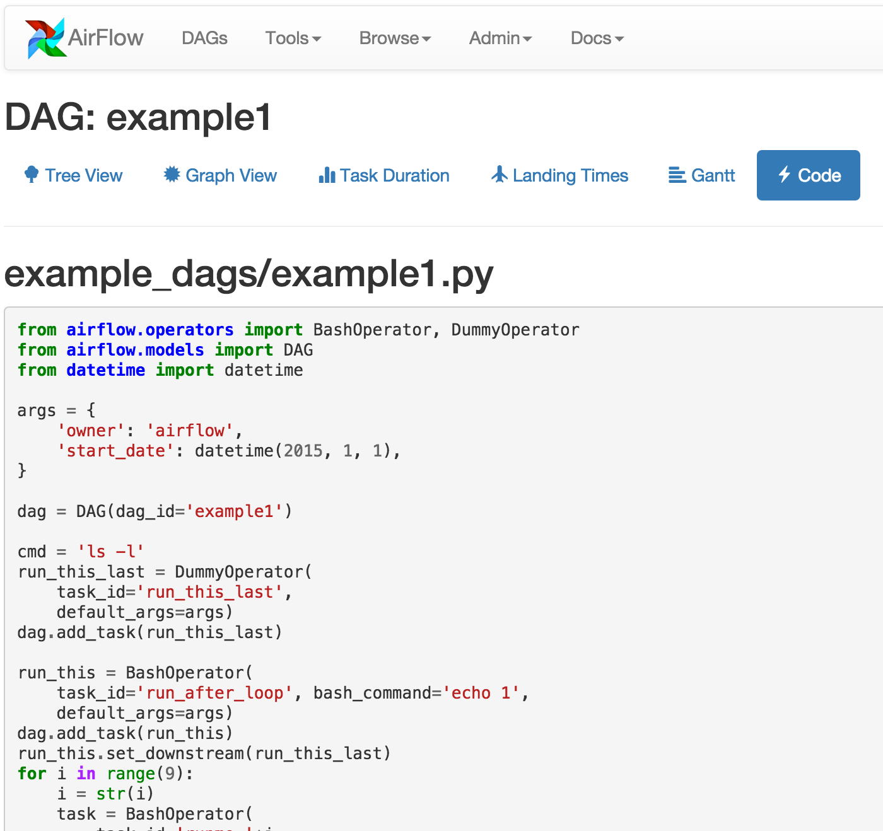
Pythonic ETL & Apache Airflow
Notes:
Apache Airflow: https://github.com/apache/incubator-airflow/
Facebook Dataswarm overview: https://www.youtube.com/watch?v=M0VCbhfQ3HQ
Amazon Data Pipeline: https://aws.amazon.com/datapipeline/

Slide 150
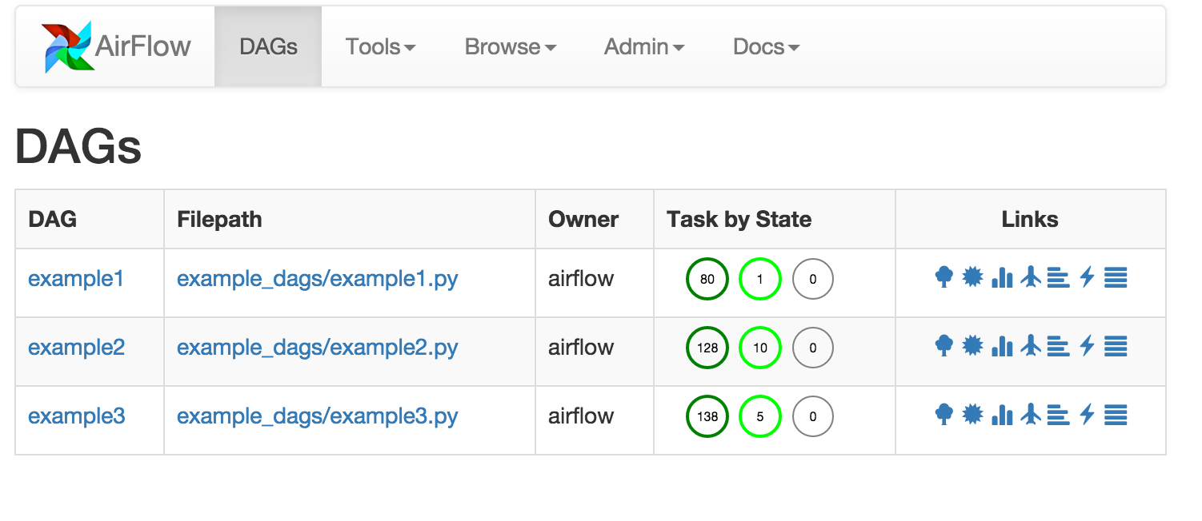
Pythonic ETL & Apache Airflow
Notes:
Apache Airflow: https://github.com/apache/incubator-airflow/
Facebook Dataswarm overview: https://www.youtube.com/watch?v=M0VCbhfQ3HQ
Amazon Data Pipeline: https://aws.amazon.com/datapipeline/

Slide 151
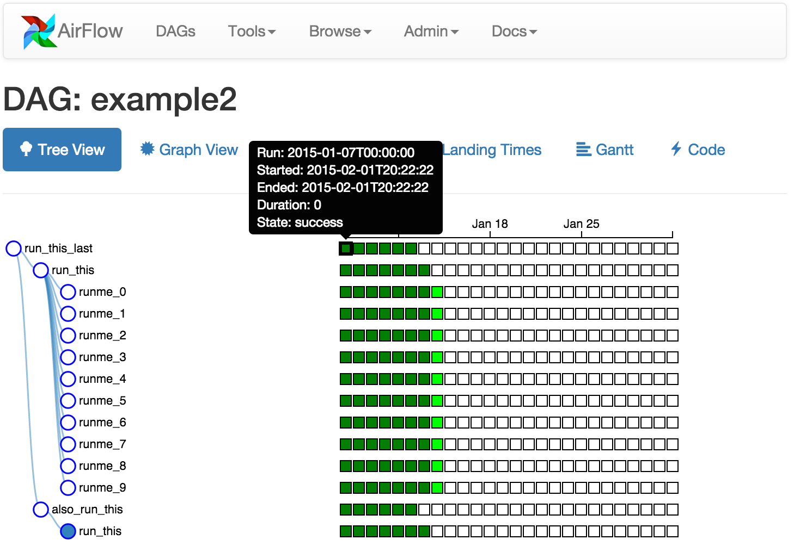
Pythonic ETL & Apache Airflow
Notes:
Apache Airflow: https://github.com/apache/incubator-airflow/
Facebook Dataswarm overview: https://www.youtube.com/watch?v=M0VCbhfQ3HQ
Amazon Data Pipeline: https://aws.amazon.com/datapipeline/

Slide 152
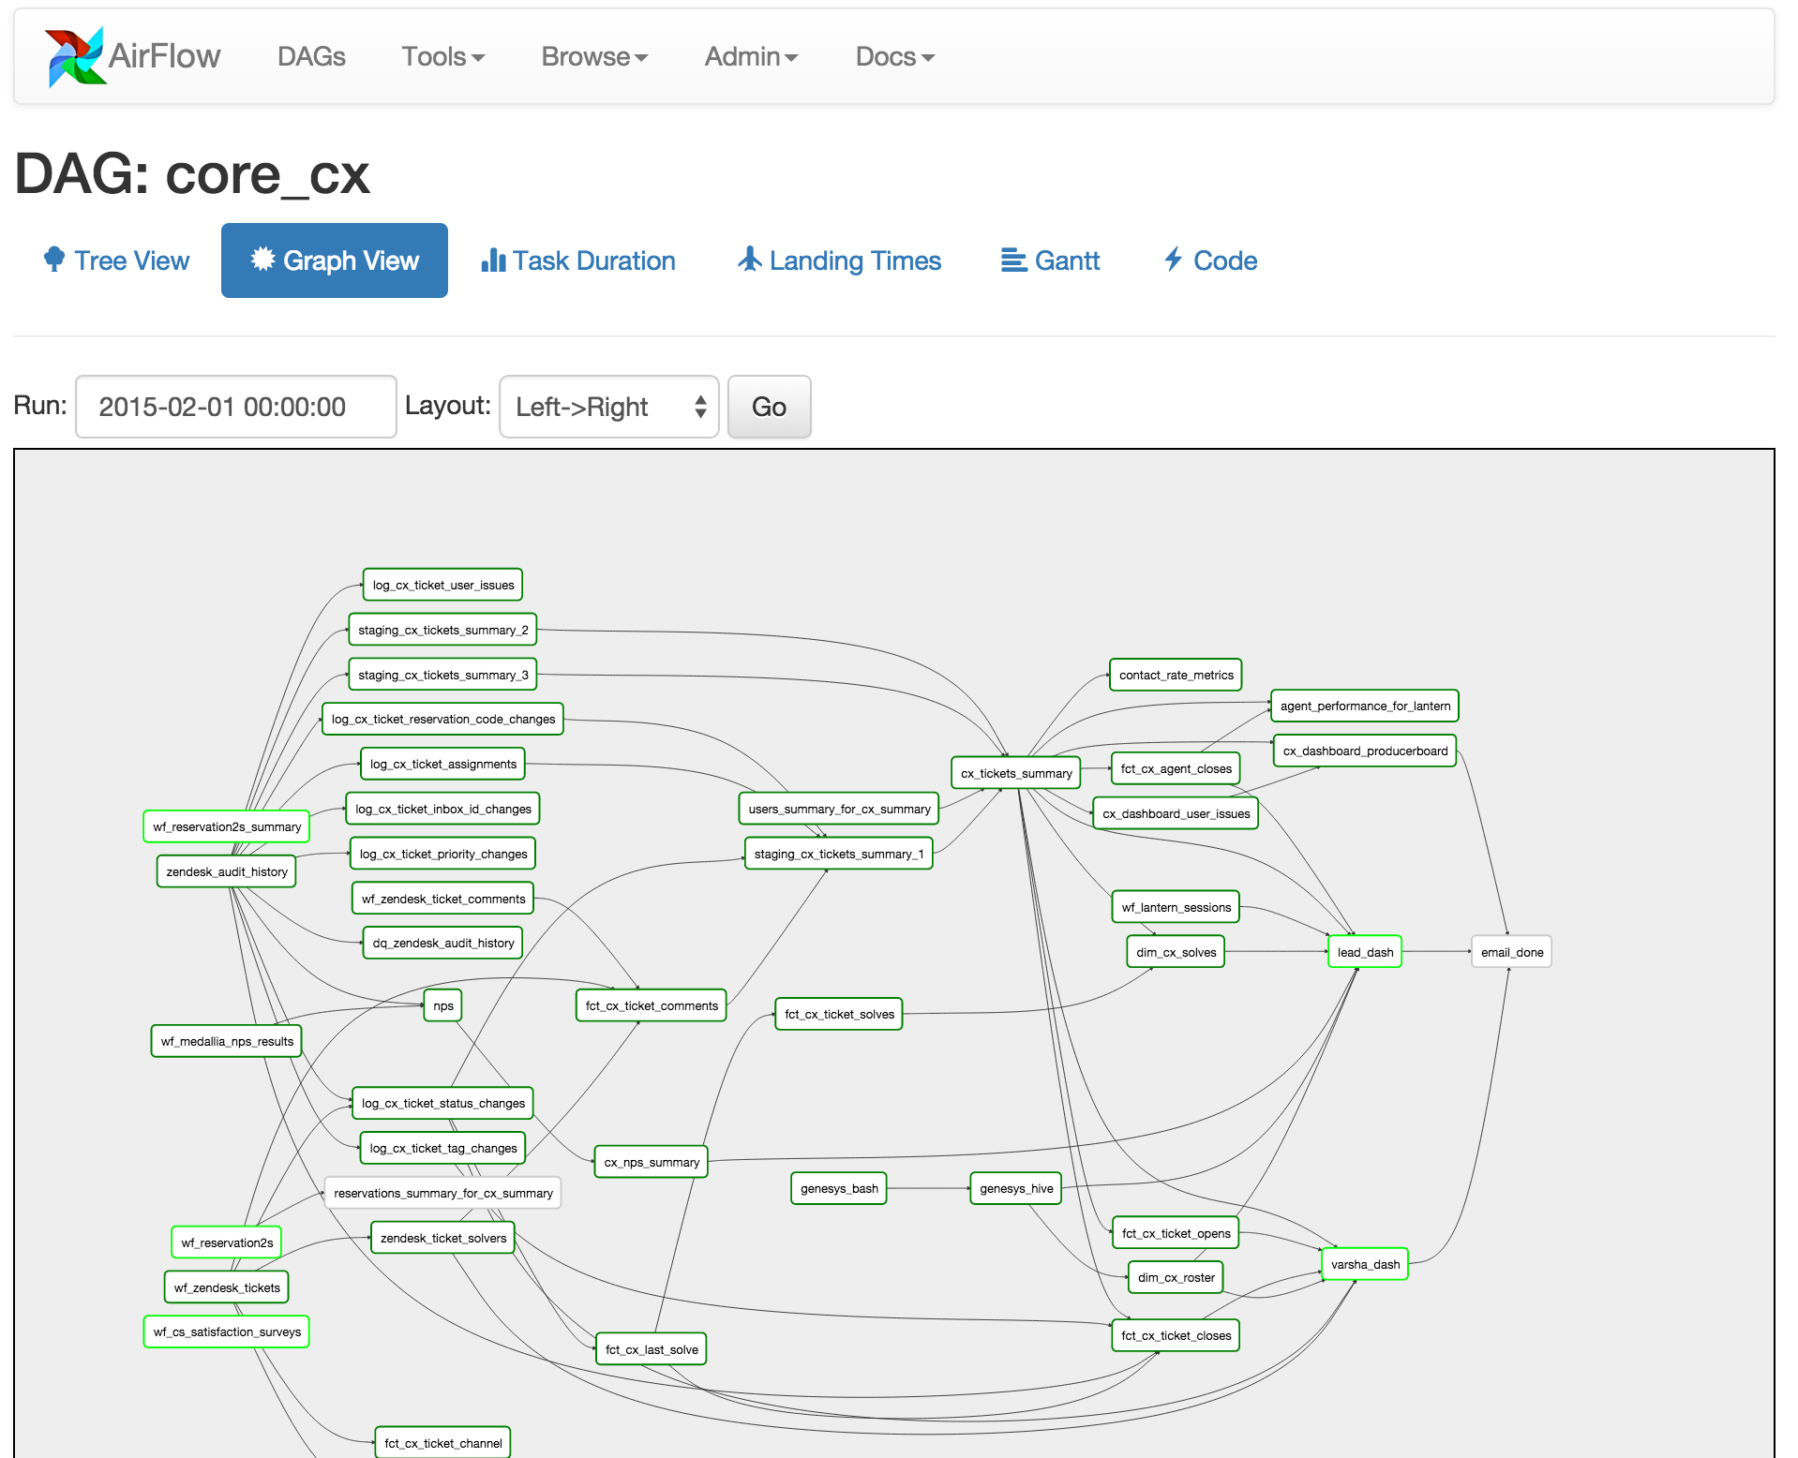
Pythonic ETL & Apache Airflow
Notes:
Apache Airflow: https://github.com/apache/incubator-airflow/
Facebook Dataswarm overview: https://www.youtube.com/watch?v=M0VCbhfQ3HQ
Amazon Data Pipeline: https://aws.amazon.com/datapipeline/

Slide 153
Contact Information
E-mail: jeff@humalytica.com
LinkedIn: https://www.linkedin.com/in/jeffreystrickland
Web site: www.humalytica.com
Skype: jeffrey.strickland2

